Slide 1
Heap and Heapsort

Slide 2
Performance of certain operations with different data structure
Array Input | Insert | Search | Find Minimum | Delete (Min)
Unsorted array
Sorted Array
Unsorted Linked List
Heap(Min)

Slide 3
Performance of certain operations with different data structure
Array Input | Insert | Search | Find Minimum | Delete (Min)
Unsorted array | 0(1) | 0(n) | 0(n) | 0(n)
Sorted Array | 0(n) | 0(log n) | 0(1) | 0(n)
Unsorted Linked List | 0(1) | 0(n) | 0(n) | 0(n)
Heap(Min) | 0(log n) | 0(log n) | 0(1) | 0(1)

Slide 4
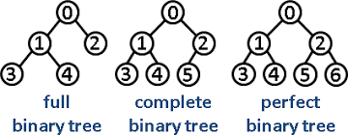
Full Binary Tree:
A binary tree is considered full if every node has either zero or two children.
In other words, no node in a full binary tree can have only one child.
All internal nodes (non-leaf nodes) must have exactly two children.
Binary trees can be categorized based on specific structural properties:
Complete Binary Tree:
A binary tree is considered complete if all levels are completely filled, except possibly the last level.
If the last level is not completely filled, all nodes in that level must be as far left as possible.
There cannot be any gaps in the filling of nodes from left to right on the last level.
Perfect Binary Tree:
A perfect binary tree is a special type of binary tree that is both full and complete.
All internal nodes have exactly two children, and all leaf nodes are at the same level (depth).
This implies that all levels of the tree are completely filled.

Slide 5
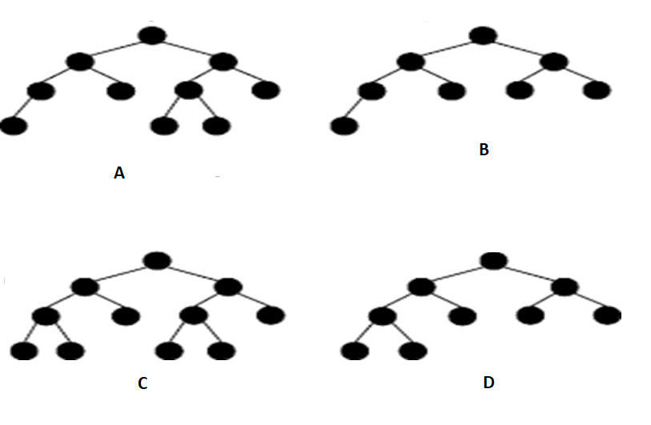

Slide 6
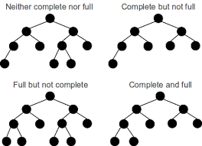

Slide 7
Heap
A Heap data structure is a binary tree with special properties:
  Heap Structure
  Partial order tree property
Definition: Heap Structure
  A binary tree T is a heap structure if and only if it satisfies the following conditions: (h = height of the tree)
    1. T is complete
    2. All leaves are at depth h or h –1
Definition: Partial order tree property
  A tree T is a (maximizing) partial order tree if and only if the key at any node is greater than or equal to the keys at each of its children (if it has any)

Slide 8
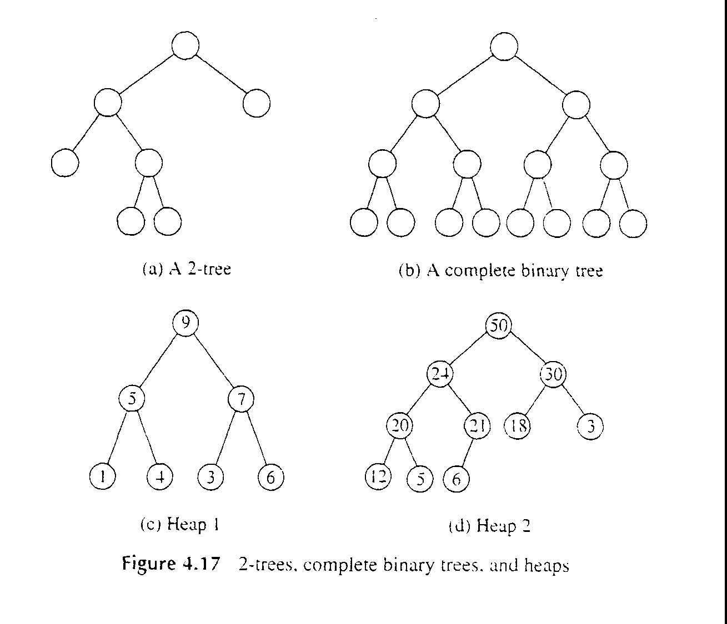
e.g. Heaps (or not)

Slide 9
Some Properties
Height of binary tree (log n)
Max. number of nodes in complete binary tree of height h is (2^{h+1} – 1)
All leaves in tree are consecutive and starts at [floor(n/2)+1 to n] (for index starts at 1 else [floor(n/2) to n] )
Every node is heap in itself
Binary heap can be implemented in array using relationship
Left_child= 2*index
Right_child = 2 *index +1
Parent of node = floor (index /2)
If index starts with 0 then
Left_child= 2*index +1
Right_child = 2 *index + 2
Parent of node = ceil(index /2) -1

Slide 10
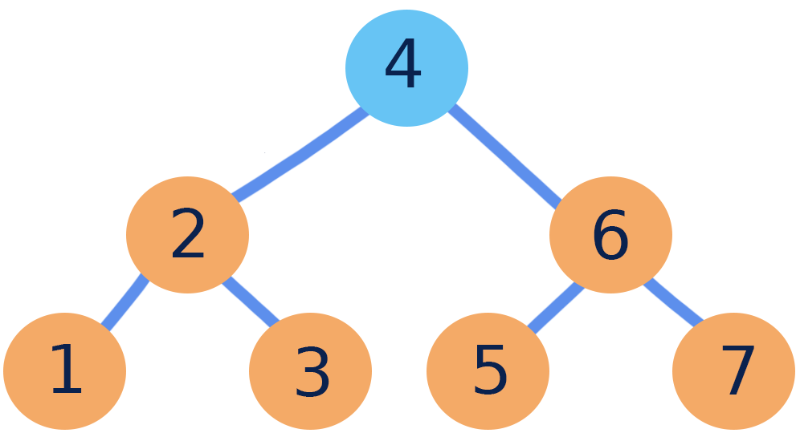
MAX-HEAPIFY(A,i)
{
l=2i
r=2i+1
If(l<=A.heap-size and A[l]>A[i])
largest=l
else largest = i
If(r<=A.heap-size and A[r]>A[largest])
largest=r
If(largest<>i)
Exchange A[i] with A[largest]
MAX-HEAPIFY(A,largest)
}
BUILD-MAX-HEAP(A)
{
A.heap-size= A.length
for(i=floor(A.length/2) downto 1*)
MAX-HEAPIFY(A,i)
}
An array with descending Order (complete tree)is Max-Heap
An array with ascending Order (complete tree)is Min-Heap
=> Sorting cost is n log n
i=floor(A.length/2) downto 1*) OR i=floor(A.length/2)-1 downto 0*)

Slide 11
MAX-HEAPIFY(A,i)
{
l=2i
r=2i+1
If(l<=A.heap-size and A[l]>A[i])
largest=l
else largest = i
If(r<=A.heap-size and A[r]>A[largest])
largest=r
If(largest<>i)
Exchange A[i] with A[largest]
MAX-HEAPIFY(A,largest)
}
0 | 1 | 2 | 3 | 4 | 5 | 6
4 | 2 | 6 | 1 | 3 | 5 | 7
Heapify (A,0) = ?
0 | 1 | 2 | 3 | 4 | 5 | 6
6 | 2 | 7 | 1 | 3 | 5 | 4
STEPS
0 | 1 | 2 | 3 | 4 | 5 | 6
4 | 2 | 6 | 1 | 3 | 5 | 7
6 |  | 4
 |  | 7 |  |  |  | 4
6 | 2 | 7 | 1 | 3 | 5 | 4

Slide 12
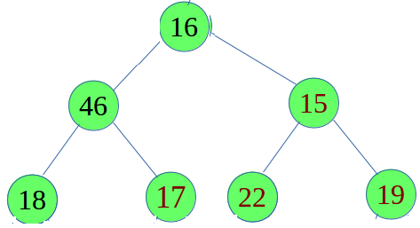
0 | 1 | 2 | 3 | 4 | 5 | 6
16 | 46 | 15 | 18 | 17 | 22 | 19
STEPS
0 | 1 | 2 | 3 | 4 | 5 | 6
16 | 46 | 15 | 18 | 17 | 22 | 19
Heapify (A,0) = ?

Slide 13
BUILD-MAX-HEAP(A)
{
A.heap-size= A.length
for(i=floor(A.length/2) downto 1*)
MAX-HEAPIFY(A,i)
}
i ➔ 2 to 0 |  | 0 | 1 | 2 | 3 | 4 | 5 | 6
 |  | 4 | 2 | 6 | 1 | 3 | 5 | 7
i=2 | i=2 Heapify(A,2) |  | Swap A[2] <->A[6] |  |  |  |  |  | i=2 l=5, r=6
 | Heapify(A,6) |  |  | 7 |  |  |  | 6 | Exit-heapify(A,6)
 |  | 4 | 2 | 7 | 1 | 3 | 5 | 6
i=1 | i=1 Heapify(A,1) | 4 | 2 | 7 | 1 | 3 | 5 | 6 | i=1 l=3, r=4
 |  |  | Swap A[1] <->A[4]
 | Heapify(A,4) |  | 3 |  |  | 2 |  |  | i=4 l=9, r=10 (X)
 |  | 4 | 3 | 7 | 1 | 2 | 5 | 6 | Exit-heapify(A,4)
i=0 | i=0 Heapify(A,0) | 4 | 3 | 7 | 1 | 2 | 5 | 6 | i=0 l=1, r=2
 |  |  | Swap A[0] <->A[2]
 | Heapify(A,2) | 7 |  | 4 |  |  |  |  | i=2 l=5, r=6
 |  | 7 | 3 | 4 | 1 | 2 | 5 | 6
 |  |  | Swap A[2] <->A[6]
 |  |  |  | 6 |  |  |  | 4 | Exit-heapify(A,4)
 | Heapify(A,6) | 7 | 3 | 6 | 1 | 2 | 5 | 4
i=floor(A.length/2) downto 1*) OR i=floor(A.length/2)-1 downto 0*)

Slide 14
i ➔ 2 to 0 |  | 0 | 1 | 2 | 3 | 4 | 5 | 6
 |  | 16 | 46 | 15 | 18 | 17 | 22 | 19
i=floor(A.length/2) downto 1*) OR i=floor(A.length/2)-1 downto 0*)

Slide 15
0 | 1 | 2 | 3 | 4 | 5 | 6
7 | 3 | 6 | 1 | 2 | 5 | 4
Heap-Extract-Max(A)
{
If A.heap-size < 1
error “ heap underflow”
max=A[1]
A[1]=A[A.heap-size]
A.heap-size=A.heap-size-1
MAX-HEAPIFY(A,1)
return max
}
STEPS
0 | 1 | 2 | 3 | 4 | 5 | 6
7 | 3 | 6 | 1 | 2 | 5 | 4
 |  |  |  |  |  | 4
4 i | 3 l | 6 r | 1 | 2 | 5
6 |  | 4
6 | 3 | 4 i | 1 | 2 | 5 l | r
 |  | 5 |  |  | 4
6 | 3 | 5 | 1 | 2 | 4

Slide 16
Complexity Analysis
Max-Heapify
Heap-Extract-Max
Build_Heap

Slide 17
Performance Analysis
Heap-Extract-Max(A)
{
If A.heap-size < 1
error “ heap underflow”
max=A[1]
A[1]=A[A.heap-size]
A.heap-size=A.heap-size-1
MAX-HEAPIFY(A,1)
return max
}
Max-Heapify takes O(log n)
Heap-Extract-Max running time is O(log n)
The running time of Build_Heap is O(n)
Number of at most node with height h ceil(n/2^{h+1})
Time taken by any Max-Heapify at any node is O(h)
MAX-HEAPIFY(A,i)
{
l=2i
r=2i+1
If(l<=A.heap-size and A[l]>A[i])
largest=l
else largest = i
If(r<=A.heap-size and A[r]>A[largest])
largest=r
If(largest<>i)
Exchange A[i] with A[largest]
MAX-HEAPIFY(A,largest)
}
BUILD-MAX-HEAP(A)
{
A.heap-size= A.length
for(i=floor(A.length/2) downto 1)
MAX-HEAPIFY(A,i)
}

Slide 18
Heap sort

Slide 19
Heapsort Strategy
The elements to be sorted are arranged in a heap
With this heap, we can build a sorted sequence in reverse order by repeatedly removing the element from the root,
Rearranging the remaining elements to reestablish the partial order tree property, and so on.
How does it work?(Max-Heapify/Build-Max-Heap/Heap-Extract-Max)
Note
Ascending and descending will always be min and max heap respectively

Slide 20
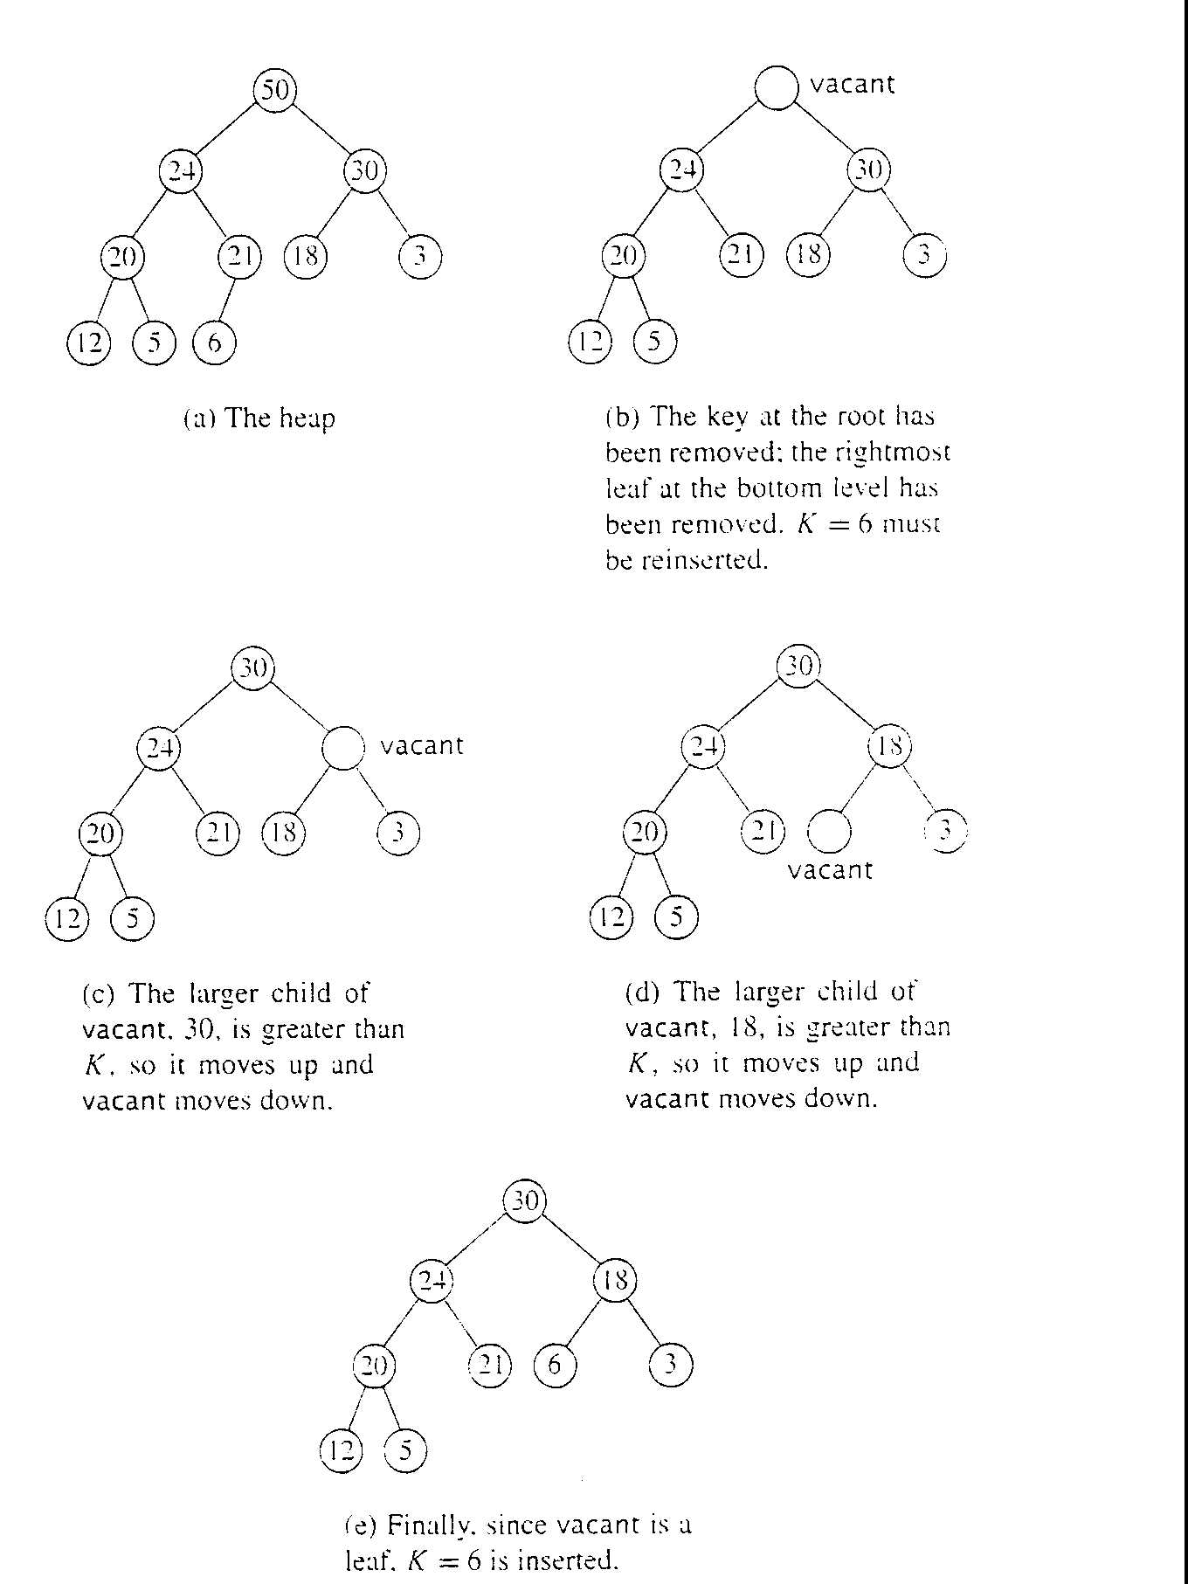
Heapsort in action

Slide 21
HEAP-SORT(A)
  BUILD-MAX-HEAP(A)
  For I ← length [A] down to 2
  Do exchange A[1] ←→ A [i]
  Heap-size[A] ← heap-size[A]-1
  MAX-HEAPIFY(A,1)
The running time of Build_Heap is O(n)
Max-Heapify takes O(log n)
(heapify to apply n-1 times)
Therefore running time is O(n log n)

Slide 22
BUILD-MAX-HEAP(A)
{
A.heap-size= A.length
for(i=floor(A.length/2) downto 1)
MAX-HEAPIFY(A,i)
}
Heap-Sort | 0 | 1 | 2 | 3 | 4 | 5
It-1 | 23 | 12 | 21 | 7 | 3 | 8
 | 8 |  |  |  |  | 23
heapify | i | L | R
 | 21 | 12 | 8 | 7 | 3 | 23
exit |  |  | i
 | 21 | 12 | 8 | 7 | 3 | 23
It-2 | 3 |  |  |  | 21 | 23
heapify | i | L | R
 | 12 | 3 | 8 | 7 | 21 | 23
heapify |  | i |  | L
 | 12 | 7 | 8 | 3 | 21 | 23
exit |  |  |  | i
It-3 | 12 | 7 | 8 | 3 | 21 | 23
 | 3 |  |  | 12 | 21 | 23
heapify | i | L | R
 | 8 |  | 3
exit |  |  | i
It-4 | 8 | 7 | 3 | 12 | 21 | 23
 | 3 | 7 | 8 | 12 | 21 | 23
heapify | i | L
exit | 7 | 3
It-5 | 7 | 3 | 8 | 12 | 21 | 23
 | 3 | 7 | 8 | 12 | 21 | 23
HEAP-SORT(A)
  BUILD-MAX-HEAP(A)
  For I ← length [A] down to 2
  Do exchange A[1] ←→ A [i]
  Heap-size[A] ← heap-size[A]-1
  MAX-HEAPIFY(A,1)
Build Max heap | 0 | 1 | 2 | 3 | 4 | 5
i→ 2 to 0 | 12 | 7 | 8 | 23 | 3 | 21
for i→2 |  |  | i |  |  | L
exit |  |  | 21 |  |  | 8
 | 12 | 7 | 21 | 23 | 3 | 8
for i→1 |  | i |  | L | R
exit |  | 23 |  | 7
 | 12 | 23 | 21 | 7 | 3 | 8
for i→0 | i | L | R
 | 23 | 12
 | for i→1 | i |  | L | R
exit | 23 | 12 | 21 | 7 | 3 | 8

Slide 24
Video Lecture of the topic can be found at
Heap – Introduction
https://www.youtube.com/watch?v=phYfC_NqfHQ
Illustrative Example of MaxHeapify BuildMax ExtractMax Procedures
https://www.youtube.com/watch?v=iCQO2OP1_TI&t=5s
Build Max Heapify ExtractMAx Analysis
https://www.youtube.com/watch?v=qcoqre-JHQU
HeapSort Strategy and Complexity Analysis
https://youtu.be/jCKWkFTZwCk
Understanding HeapSort with an Illustrative Example
https://youtu.be/_UZ1gf0M0GM

